Slide 1
Domain Specific Software Engineering (DSSE)
Software Engineering, just as other engineering disciplines, needs to take into account of the different domain in which it is working.
Consider the engineering of Electric Coffee Machine (household appliance) versus the engineering of Airplane (avionics):
  We may design the electric coffee maker in such a manner that it is focused on properties such as speed of heating, electric safety, and looks; but we know if it breaks the user will just go buy a new one --- do not worry about maintenance (reusable parts & replacement) too much.
  We may design commercial airplanes for super reliability and safety first. Thus we want to design for frequent maintenance (reusable parts and replacement). Then we are concerned with speed and comfort. We are not concerned with the “looks” of the airplane.
Our design concerns differ based on the different problem domain.

Slide 2
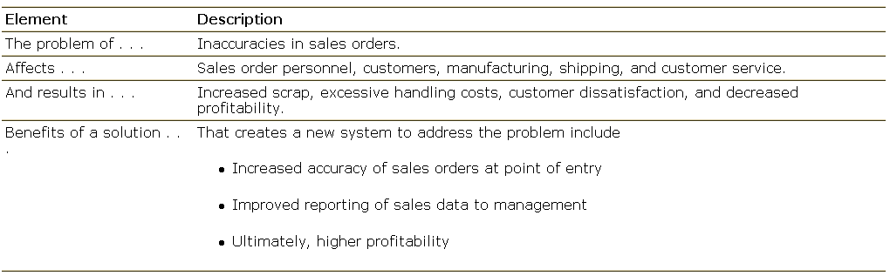
Example: Sales Order Problem Statement

Slide 3
Step 2: Understand the Root Causes (The Problem Behind the Problem)
Root cause analysis is a systematic way of uncovering the root, or underlying, cause of an identified problem or a symptom of a problem.
Example: a mail-order catalogue company addresses the problem of insufficient profitability
  cost of non-conformance: cost of waste produced
    Too much scrap

Slide 4
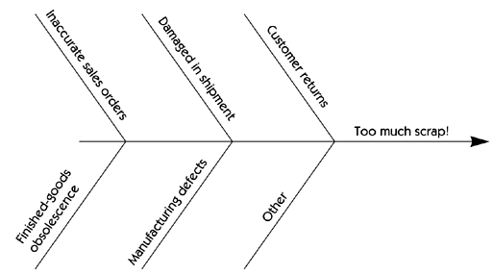
Fishbone Diagram of Root Causes

Slide 5
Unfolding the Problem
Problem to Solve Technique Applied
Lack of Profitability Total Quality Management
↓
Cost of Conformance Fishbone Diagram
↓
Too much scrap Pareto Chart
↓
Inaccurate sales orders New software solution

Slide 6
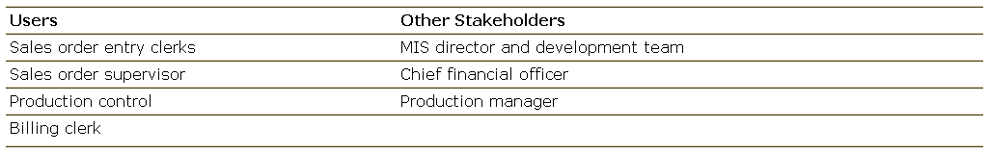
Example: Users and Stakeholders of Sales Order Entry System

Slide 7

Step 4: Define the Solution System Boundary
We divide the world in two:
  Our system
  Things that interact with our system
System Boundary is an interface between the system and the environment or other systems

Slide 8
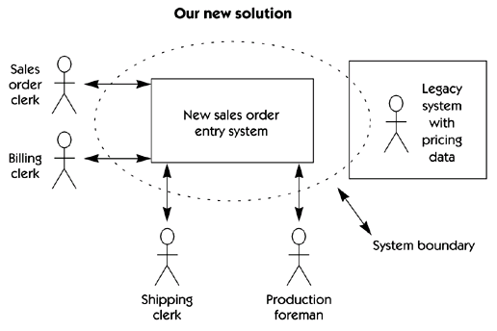
System Perspective
It is a block diagram that describes the boundaries of the system, the users, and other interfaces

Slide 9
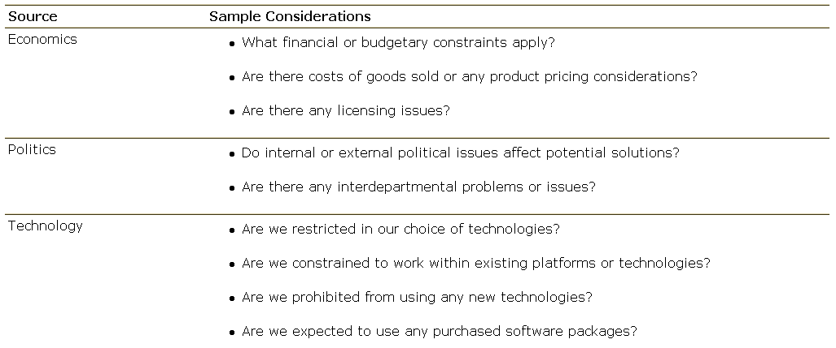
Potential Sources of System Constraints

Slide 10
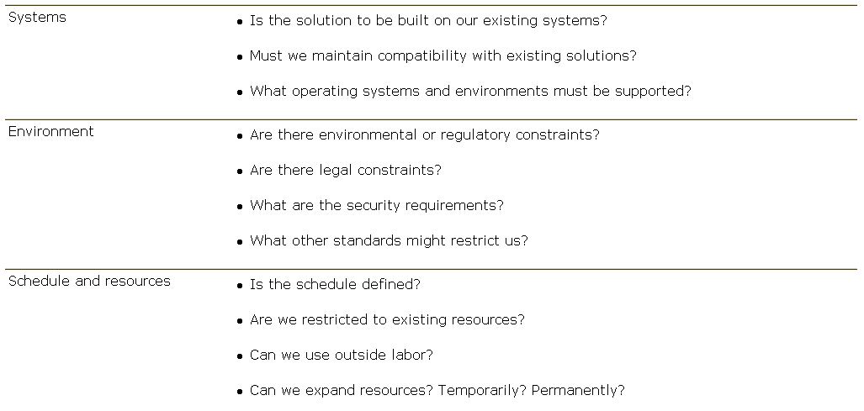
Potential Sources of System Constraints

Slide 11
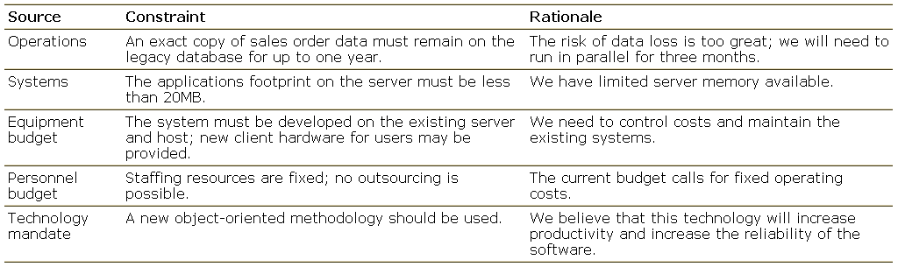
Sources of Constraints and Their Rationale for Sales Order Entry System

